Slide 1
Estimation of Fluctuation of Energy for the Design of the Flywheel
Fluctuation of energy can be estimated from two sources:
From the turning moment diagram when:
(i) TM diagram is represented through regular geometrical figures
(ii) TM curve is represented through trigonometric function
(iii) when variation of energy level is given through the areas above and below the mean torque line
2. From the indicator diagram

Slide 2
Problems - Type 1 (i)
During the outward stroke of the piston of a double acting steam engine the turning moment has a maximum value of 18000 Nm when the crank makes an angle of 60⁰ with the TDC. During the inward stroke the maximum turning moment is 14000 Nm when the crank angle is 280⁰. If T-θ diagram for both strokes are triangular and torque supplied by the engine is constant find the angles at which engine speed will be maximum and minimum. If the crankshaft speed is 80 rpm, the diameter of the rim-type flywheel is 3 m, and the speed is to be kept within 0.5% of the mean speed, what weight of flywheel will be required?
A single cylinder single acting four stroke gas engine develops 300 IHP at 300 rpm. Work done by gas during expansion stroke is three time the work done on the gas during the compression stroke. Work done during exhaust and suction stroke is negligible. If fluctuation of speed is not to exceed +/- 2% of the mean speed and the TM diagram during the expansion stroke is assumed to be triangular in shape, find the MOI of the flywheel.
A machine shaft runs at a mean speed of 320 rpm. The torque required by the machine increases uniformly from 500 Nm to 2000 Nm while the shaft turns through 40⁰, remains constant for next 100⁰, decreases uniformly to 500 Nm for the next 40⁰ and then remains constant for the next 180⁰. The power is supplied by a constant torque motor and the fluctuation of speed is limited to 4% of the mean speed. Find: (a) HP of the motor, (b) maximum fluctuation in energy and (c) MOI of a suitable flywheel fitted to the machine shaft.

Slide 3
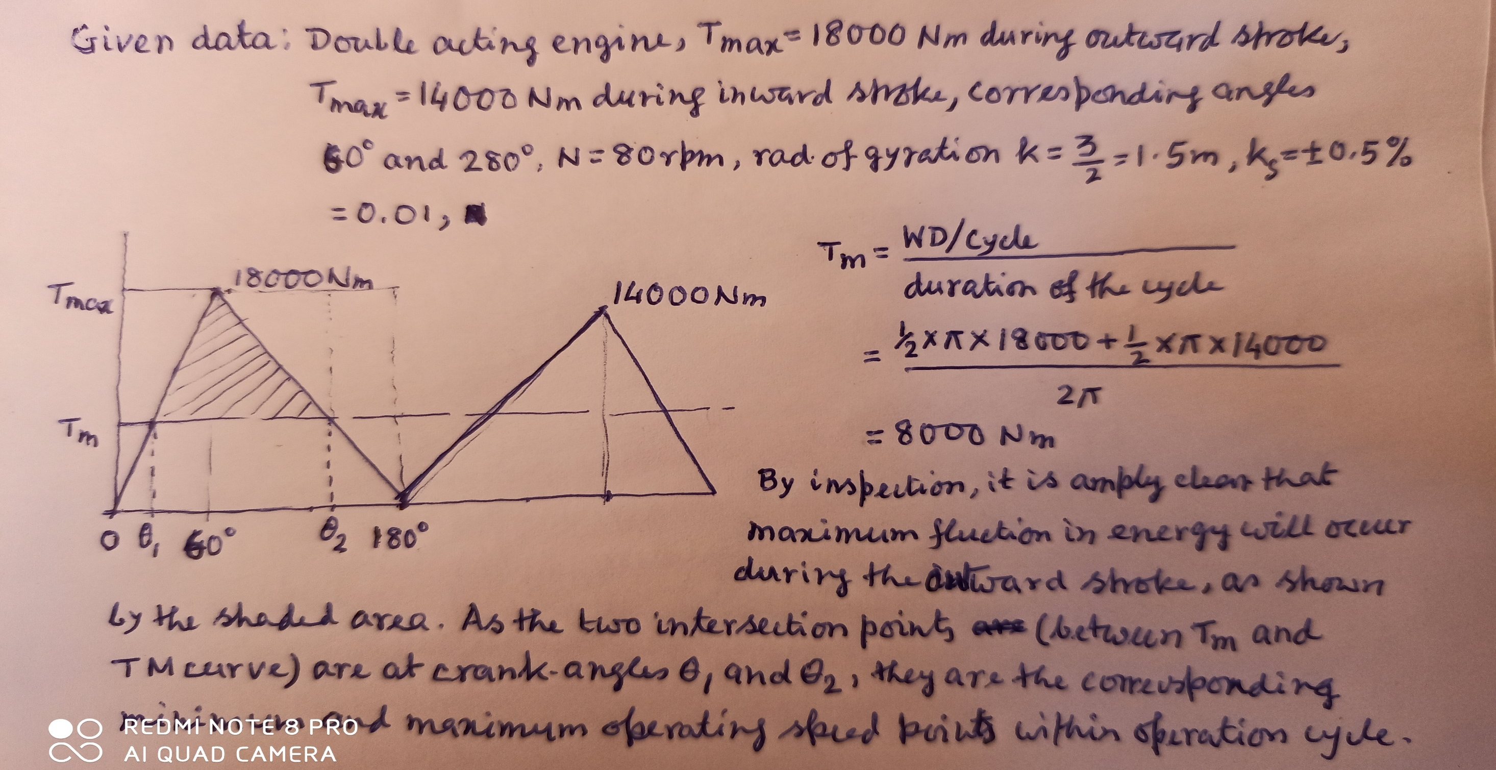
Solution of Problem 1

Slide 4
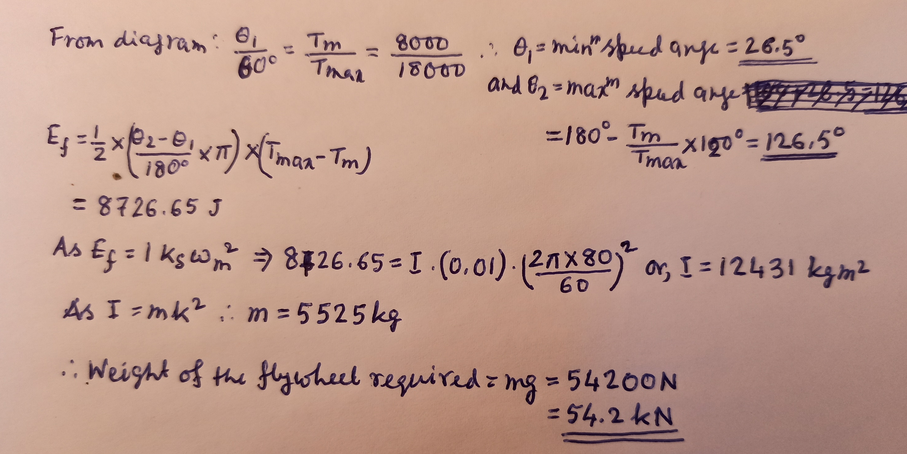
(Continued)

